Slide 1

ICT 581 HTML5 and CSS3 with jQuery
Continuing Education
Day 6: React.js State, Events and Lifecycle
Mostafa Mohamed, PhD, P.Eng.
Adjunct Professor,
Electrical and Software Engineering Department
Mostafa.Mohamed@ucalgary.ca
@ 2022

Slide 2
Previous Class
React.js JSX
Elements
Components and Properties

Slide 3
Agenda
React State and Lifecycle
Events
Conditional Rendering
Reading:
https://reactjs.org/docs/state-and-lifecycle.html
https://reactjs.org/docs/handling-events.html
https://reactjs.org/docs/conditional-rendering.html

Slide 4
Arrow function
This is a JS ES6 new syntax for creating a function
Read more here:
https://www.w3schools.com/Js/js_arrow_function.asp
See day6-demo0-arrow-function.html

Slide 5
React State and Lifecycle

Slide 6
React.js State and Lifecycle
A component’s State holds all internal variables that describe the component at certain state
Changing the state should re-renders the component
This things will enforce React to re-render your companies:
Referencing any state variable in the render method
Referencing any property (props) in the render method
To add state to your component, we need to use Class component and create the state in the class constructor

Slide 7
Create the state Object in the constructor
class ColorBox extends React.Component {
constructor(props) {
super(props); # always pass props to my parent class
this.state = { color: this.props.color };
}
render() {
return (
<div style={{ backgroundColor: this.state.color }}>.</div>
);
}
}
Because we reference a state variable in the render method, any change in the state will re-render the component

Slide 8
Lifecycle Methods in a Class
React classes have lifecycle methods
These are built-in methods that get called when certain lifecycle event happen
Two main lifecycle methods that can be used to set recourses and clear resources
componentDidMount(): runs after the component output has been rendered
componentWillUnmount(): runs before the component get removed

Slide 9
Changing State
You set the state using “this.state = … “ only in the constructor
If you want to change the state values outside the constructor, use this.setState() method
componentDidMount() {
this.myTimer = setInterval(
() => {
this.setState((state, props) => {
return { counter: state.counter + 1 };
})
}, 1000 );
}
See: day6-demo2-state-change.html
The current value of the state.counter

Slide 10
The Data Flows Down
Always send the data from parent component to its children. It is a bad practice to read values from a child. Sore all needed values by the parent, inside the parent and send them to child as properties
<ColorBox color='#fa5' />

Slide 11
React Events

Slide 12
React Events
Like HTML events with some differences:
React events are named using camelCase, rather than lowercase.
With JSX you pass a function as the event handler, rather than a string.
HTML button
<button onclick="increment()">Increment</button>
React Button
<button onClick={increment}>Increment</button>

Slide 13
Event Handler
An event handler is a method you add inside the class
You can either user regular function style (without ‘function’ keyword), or use arrow function
Regular functions will need to be bound with the this keywork in the constructor
Arrow functions don’t need binging
See day6-demo3-events.html

Slide 14
Example event handlers
constructor(props) {
super(props);
this.state = { count: this.props.count };
this.handleIncrement = this.handleIncrement.bind(this);
}
handleIncrement() { // Regular function need binding this
this.setState((state, props) => {
return {
count: state.count + 1
}
})
}
handleDecrement = () => { // Arrow function doesn't require binding
this.setState((state, props) => {
return {
count: state.count - 1
}
})
}

Slide 15
Conditional Rendering

Slide 16
Conditional Rendering
JSX allows you to use JavaScript to control what to render and how to render it, and even if it should render it or not
I can use a condition on JSX to show or hide any part of my component

Slide 17
Example Conditional Rendering
render() {
return (
<div>
<div>Current count: {this.state.count}</div>
{ this.state.count > 0 && // This is a condition for rendering the component
<button onClick={this.handleDecrement}>--</button>
}
<button onClick={this.handleIncrement}>++</button>
</div>
);
}

Slide 18
Activity

Slide 19
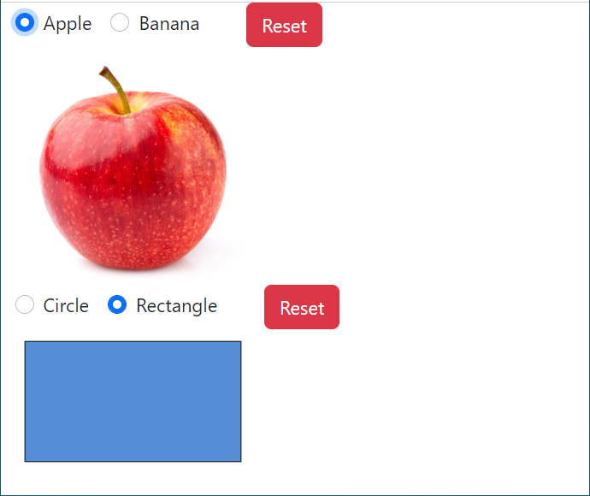
Create a Dynamic page
Create a component to ask the user for choices
Create a second component to show an image of the selected choice

Slide 21
Assignment 2
A- Create HTML page with these React components:
1- Header: shows a nice banner image
2- Footer: shows your name and copyright
3- Main body: ask the user to enter two values and choose an operation from: +, -, *, /, ** then show the next component base on the user selection
4- Sub body: a component to the operation results with description such as “2.5 * 2 = 5.0” if the user choose multiplication , or “2.5 + 2 = 4.5” if the user choose addition

Slide 22
Assignment 2 - continued
B- Create HTML page to show game cards:
Create a component to draw a game card, the properties should include: color, value, and flipped (show the value or not)
Create a deck to show a group of cards (8 cards of each type and color)
If the user clicks on a card, the card should flip
Use SVG icons from below
https://icons.getbootstrap.com/icons/heart-fill/
https://icons.getbootstrap.com/icons/suit-spade-fill/
https://icons.getbootstrap.com/icons/suit-club-fill/
https://icons.getbootstrap.com/icons/suit-diamond-fill/

Slide 23
Summary
React State and Lifecycle
Events
Conditional Rendering

Slide 24
Thank you for attending today!!!
Mostafa Mohamed, PhD, P.Eng.
Mostafa.Mohamed@ucalgary.ca
WhatsApp: 403-966-8112

